Slide 1
Making Your Training Records Stick!!!

Slide 2
Topics Covered:
Training Requirements
Online Training

Slide 3
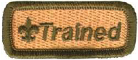
What Makes a Trained Leader?
A direct contact Scout leader is considered fully trained and entitled to wear the Trained leader emblem when the following training courses are completed:
Youth Protection Training is the first step for any new adult volunteer.
Fast Start Training is to be delivered immediately after a new leader registers and before he or she meets with any youth member.
This is Scouting for all unit-level leaders
Leader Specific Training, which is based on the leader's unit-level position.

Slide 4
What Makes a Trained Leader?
Cub Scout leaders are considered trained when they have completed
This is Scouting
Cub Scout Leader Specific training for their position.

Slide 5
What Makes a Trained Leader?
Scoutmasters and assistant Scoutmasters are considered trained when they have completed This is Scouting, Scoutmaster and Assistant Scoutmaster Leader Specific Training, and Introduction to Outdoor Leader Skills.

Slide 6
What Makes a Trained Leader?
Troop committee members are considered trained when they have completed This is Scouting and the Troop Committee Challenge as their Leader Specific training.

Slide 7
What Makes a Trained Leader?
Varsity Scout leaders and assistants are considered trained when they have completed This is Scouting, Varsity Scout Leader Specific Training (available April 2002), and Introduction to Outdoor Leader Skills.

Slide 8
What Makes a Trained Leader?
Venturing crew Advisors, assistant Advisors, and crew committee members are considered trained when they have completed This is Scouting and Venturing Leader Specific Training.

Slide 9
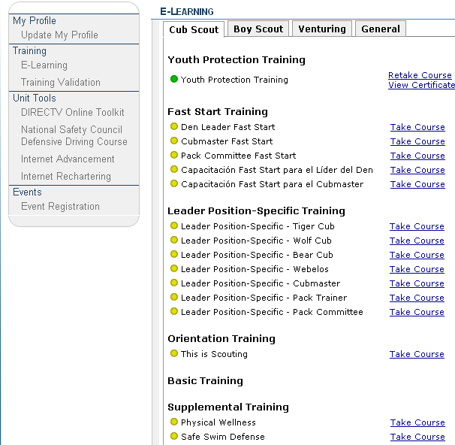
Online Learning Center
The BSA Online Learning Center (E-Learning) provides a variety of materials, from quick references to complete training courses, all designed to help our members improve leadership skills and deliver a quality program.
Many trainings,
including Youth
Protection Training ,
are available online
through Scouting.org>
MyScouting

Slide 10
New Leader Training in MyScouting
Open www.scouting.org and select MyScouting
Click on “Create an account”
Click “I am new and don’t know my member ID” and then click “Next”
Complete the Profile Information screen and then click “Create User”
Login to MyScouting and from the menu on the left, click E-Learning and then from the General tab, scroll down to Youth Protection Training and click Take Course.
Upon completion, they may print a certificate of completion

Slide 11
New Leader Training in MyScouting
Once a volunteer receives a BSA membership card which includes their member ID number, they should log back into MyScouting, click on My Profile and update the system by inputting their membership ID number. This will link all trainings taken in MyScouting to their membership record in PAS.
*You do not have to be a registered member or have a member ID to take training in MyScouting.

Slide 12


972-580-2267 Volunteers only
myscouting@scouting.org

